Slide 1
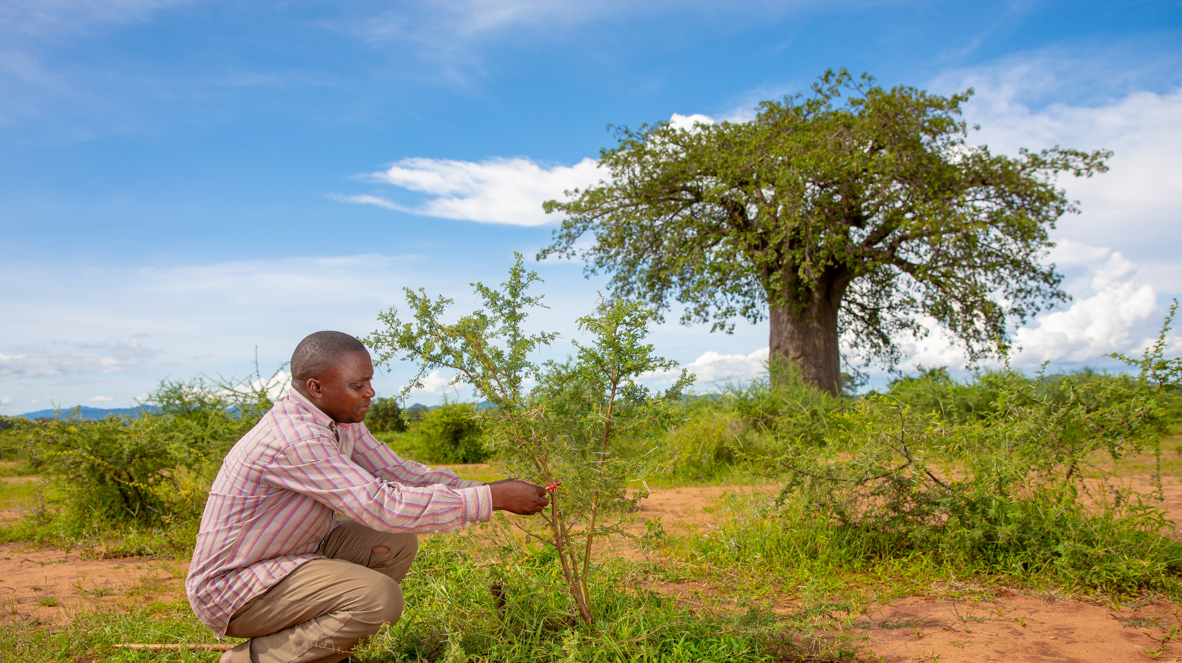
PROGRESS REPORT
January 2022

Slide 2
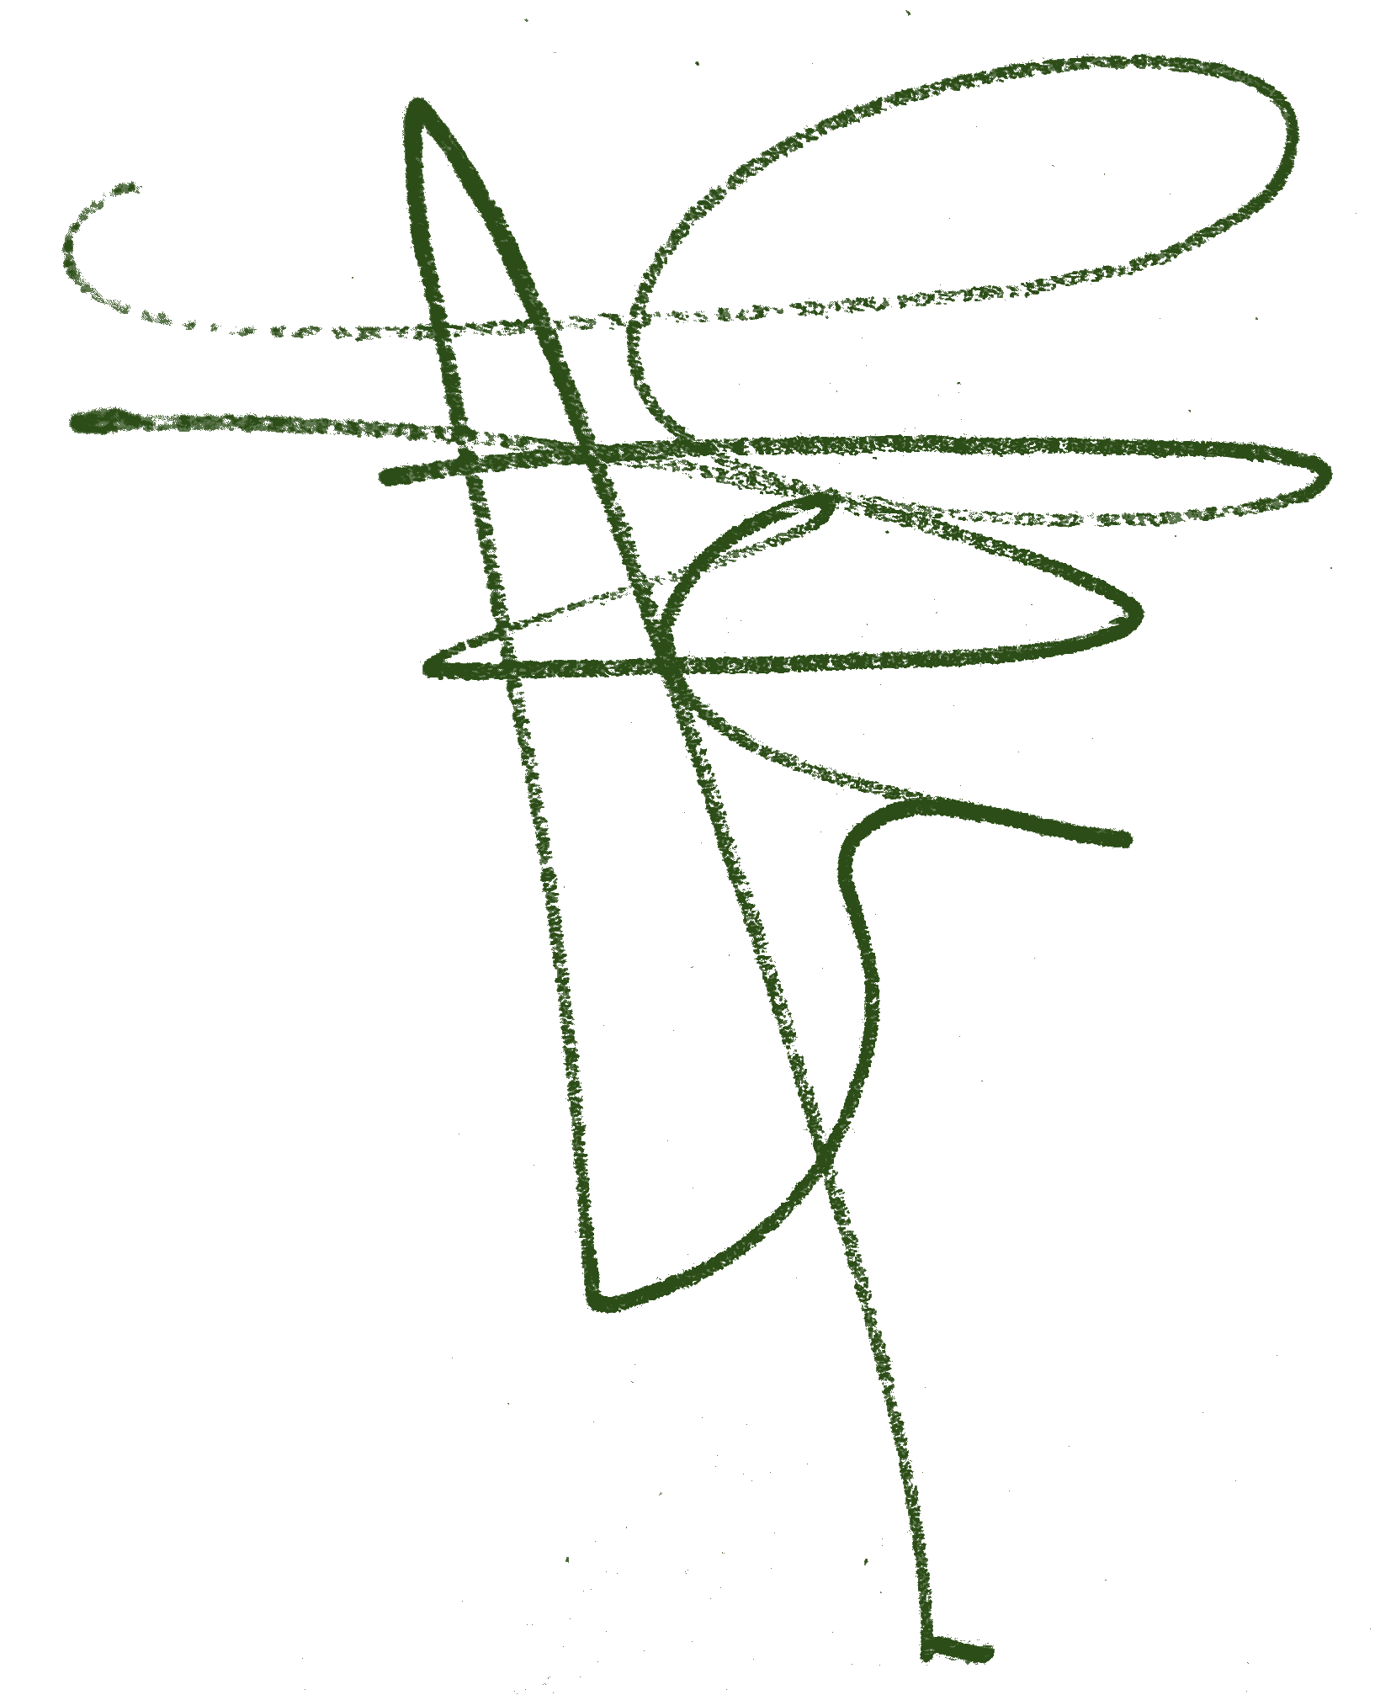
JUSTDIGGIT UPDATE
Dear Philip Friedel,
To start this progress report, I would like to take the opportunity to thank you again for supporting Justdiggit and our project in Tanzania. With this report, I would like to give you a general update about Justdiggit, our regreening program in Singida and the impact that has been realised so far – partly thanks to your donation!
As you know, we recently launched our new program in the Singida region in Central Tanzania. This program will have a primary focus on FMNR, topped up with rainwater harvesting interventions and sustainable agricultural practices. Within the next five years, we aim to restore over 8 million trees and positively impact over 375,000 people! In this report, we will go more into depth into this new program.
Also in Kenya, we are working hard to increase our impact. We are currently designing a new program with SORALO in the South Rift Valley in the southern Kenya, while we are in the final preparation stages of starting with the TWENDE program in the Chyulu Hills. In both programs, we will use nature-based solutions to restore degraded landscapes for the benefit of both local communities and wildlife.
About a year ago, opened our new Regional Office East Africa in Nairobi. Since then, we have been growing rapidly, as we currently have seven people working here! So far, it has very good to be closer to the program areas, the communities and our implementing partners. This way, we are able to do our work even better and make an even bigger impact!
I hope this report will give you a good update on newly launched program and the villages that are supported with your contribution. Please do not hesitate to contact us for any additional questions.
Kind regards,
Marjolein Albers
Director Justdiggit Foundation

Slide 3
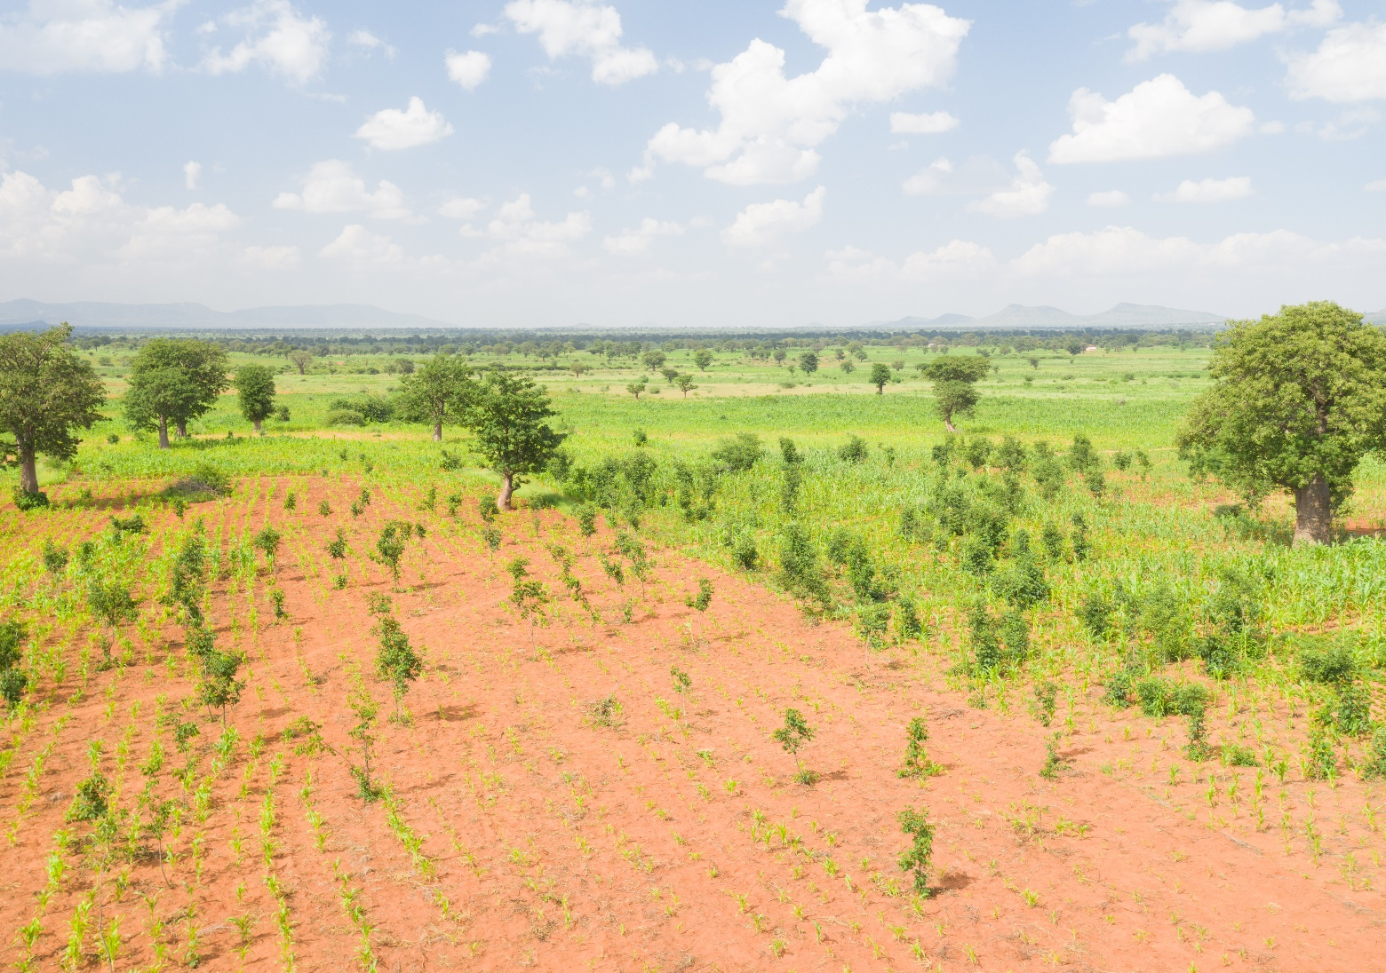
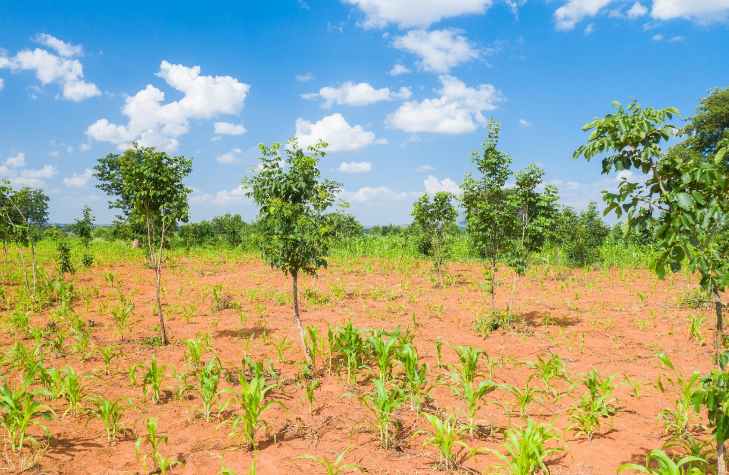
PROGRAM SETUP
In May 2021, Justdiggit and LEAD Foundation expanded their successful Regreening Dodoma Program to the neighboring region of Singida. In the Dodoma region, over 120,000 smallholder farmers are involved in the regreening program and together regenerated over 9.15 million trees. With this new Singida program, Justdiggit and LEAD Foundation aim to regenerate another 8.1 million trees in the coming 5 years. The program will exist of three phased clusters, of which the first, containing 66 villages, started in 2021.
In this program, we aim to train over 100,000 smallholder farmers to bring back trees on their farmland through Farmer Managed Natural Regeneration (FMNR). When the agricultural area expanded, many trees were chopped down. However, as the trees stumps and root systems are often still intact, these tree stumps sprout into bushy vegetation which is unfavorable for farmers and crop production. With FMNR, we teach farmers how to prune these tree stumps in such a way that they can regrow into a full-fledged tree. As these are often indigenous tree species, they are adapted to the dry and hot climate. This, together with the fact that their root systems are already established, strongly boosts the survival rate of these trees compared to tree planting programs. This intervention is locally known as Kisiki Hai, meaning Living Stump.
Besides teaching farmers the technicalities of FMNR, it is crucial to explain them how backing trees can provide them many benefits. Firstly, when many trees are regenerated, the micro-climate may cool down substantially, reducing heat stress for crops and reducing excessive evaporation of groundwater. Trees also can improve soil quality, enhance rainwater retention in the soil, provide fodder for livestock and give the farmer direct benefits such as fruits, medicines and firewood.
Maize field with numerous young FMNR trees
FMNR practiced in a field of maize
Note that all pictures in this report are made in the Dodoma region. Since the Regreening Singida Program launched recently, no pictures are available yet.

Slide 4
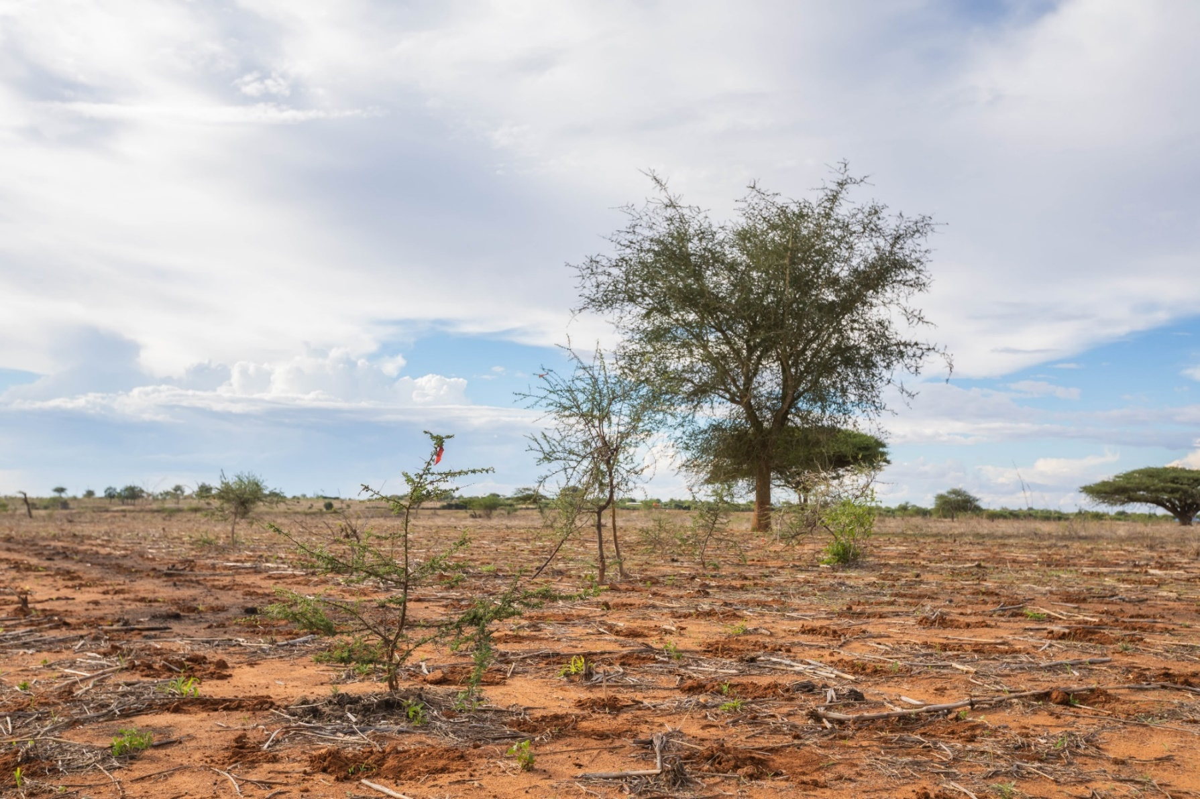
CHAMPION FARMERS
Together with our implementing partner LEAD Foundation in Tanzania, we train so called champion farmers. These farmers will play a leading role in our program and are selected based on their knowledge, skills and position within their communities. They receive a training of several days on the technicalities of our regreening interventions, but also on leadership skills, reporting and on how to train others. After that, they return to their villages and start training other farmers. In the last few months, we trained the last champion farmers, who are now spreading the regreening movement in their villages!
Champion farmers are not only crucial in spreading knowledge and activating farmers, as they also play a major role in our monitoring system. After they train farmers, they do regular check-ups including counting trees in the field. They collect statistics about number of trees and trained and activated farmers and communicate this with the program office, where the progress of the program is being monitored. In order to be able to show the impact of the program, we have recently conducted a baseline study. We visited 7 program and 4 non-program villages and interviewed over 400 farmers about their farming practices, socio-economic situation, attitude towards regreening and several other topics. As the program progresses, we will revisit these villages to see which changes can be observed.
Two young FMNR trees, marked with a piece of red fabric, in Lengaji village, Dodoma.

Slide 5
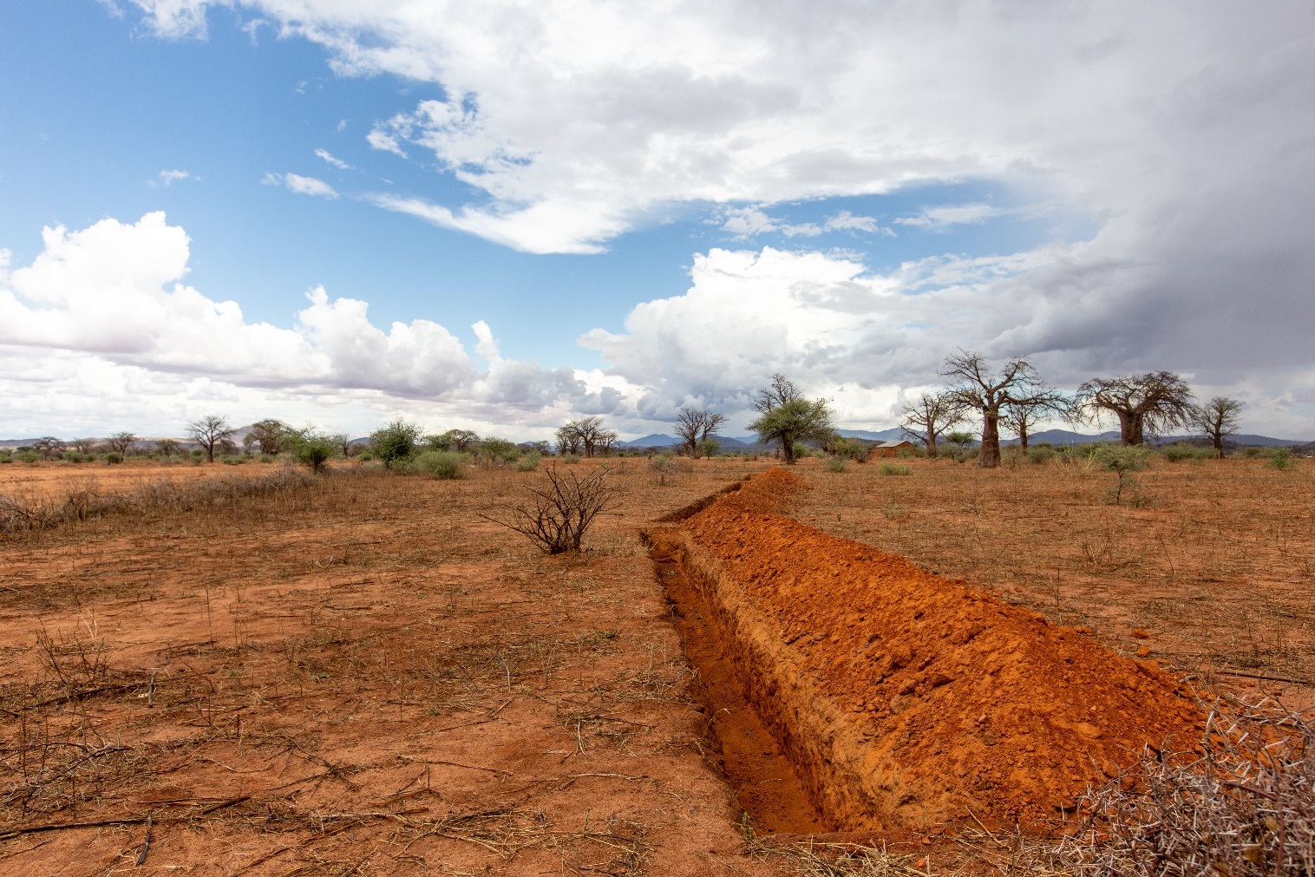
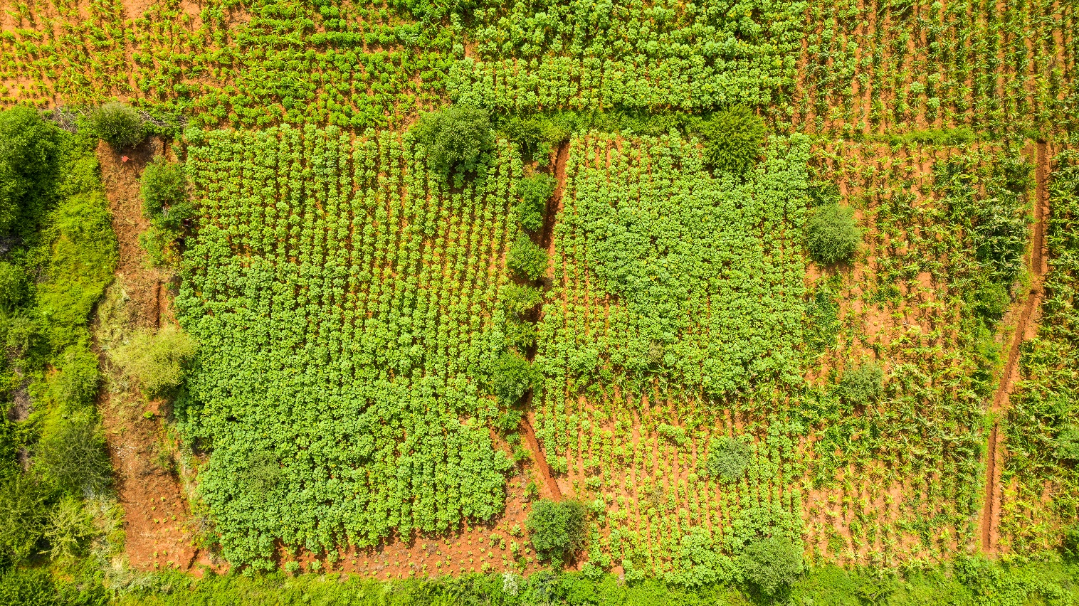
FANYA JUU, FANYA CHINI
As in the Dodoma program, we will implement rainwater harvesting interventions in specific areas. Explaining how this works may become a bit technical, so we will try to explain it without going too much into the details. Combining Fanya Juu and Fanya Chini is a water-harvesting technique that is widely used in African agriculture. Fanya Chini literarily means “throw it downwards” in Kiswahili, while Fanya Juu translates to “throw it upwards” – and these terms accurately describe what the intervention is all about. Farmers dig trenches along the contours of the farm and throw the soil they dug up either upslope or downslope. When it rains, especially on sloped areas, large amounts of rainwater can run off and flow downstream before it can infiltrate, which often causes soil erosion. As this limits the amount of water that infiltrates on the farm, less water will be available for crops during the growing season and after the rains. ‘Fanya trenches’ prevent these issues, by catching water that runs off so that it can still infiltrate the soil. This way, Fanya Juu/Chini is both a water-harvesting technique and an anti-erosion intervention.
In a farm field, farmers often construct multiple trenches ‘behind’ each other, with a distance of about 15 meters. The most upslope trench is a Fanya Chini (soil thrown downslope) and will catch any runoff coming from above. The trenches below are Fanya Juus, where the soil that is thrown upslope stops any runoff so it can infiltrate. While doing that, sediments that are taken by the runoff will settle here as well. As a consequence, the area between two trenches will gradually become more level, and natural terraces will emerge. As the slope of the land gradually reduces, rainwater will infiltrate the soil more easily, reducing destructive erosion and increasing the amount of water that is available in the soil throughout the year.
A recently constructed trench with adjoining ridge. As the fanya’s are constructed right before the rains start, at the end of the dry season, the farm looks dry and barren.
Three fanya trenches dug straight through a field. By capturing rainwater, the trench provide water to the crops
Notes:
Note: to be reported on in the next report

Slide 6
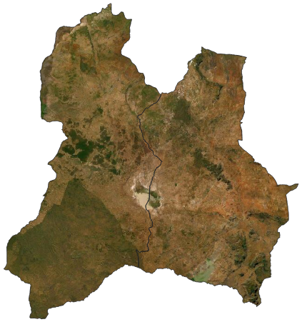
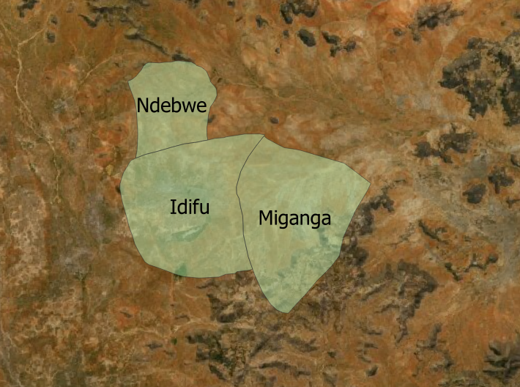
ALLOCATED VILLAGES
InTime will support 15 villages in the Regreening Singida Program, spread out over five years. Last November, the program has started in the first three villages: Ndebwe, Idifu and Miganga. The location of these villages is shown in figure on the right. For the next four years, 3 new villages will be added to the program every year. By the end of the program in 2028, we expect to have regenerated over 204,000 trees, brought 5,000 hectares of land under restoration and positively impact over 26,000 people. Furthermore, these trees will sequester an estimated 39,000 tonnes of CO2 in their first 20 years of growth!
In the following reports, we will provide insights into the progress into the specific villages in your village cluster. This impact will start off small and gradually grow over time. Early in the program, the number of activated farmers will be limited, as will the number of trees per farmer be. Both will keep increasing over the progress of the program. Each progress report will contain an update on the most recent impact.
Dodoma and Singida regions in Central Tanzania
Village cluster supported by InTime

Slide 7
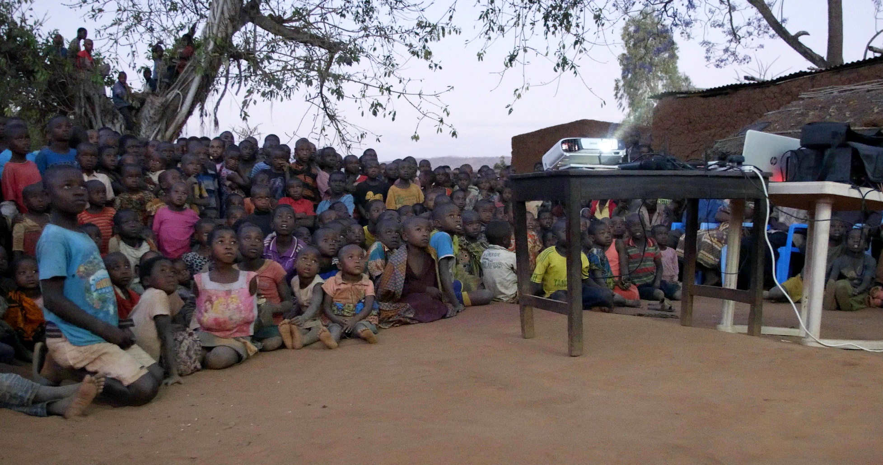
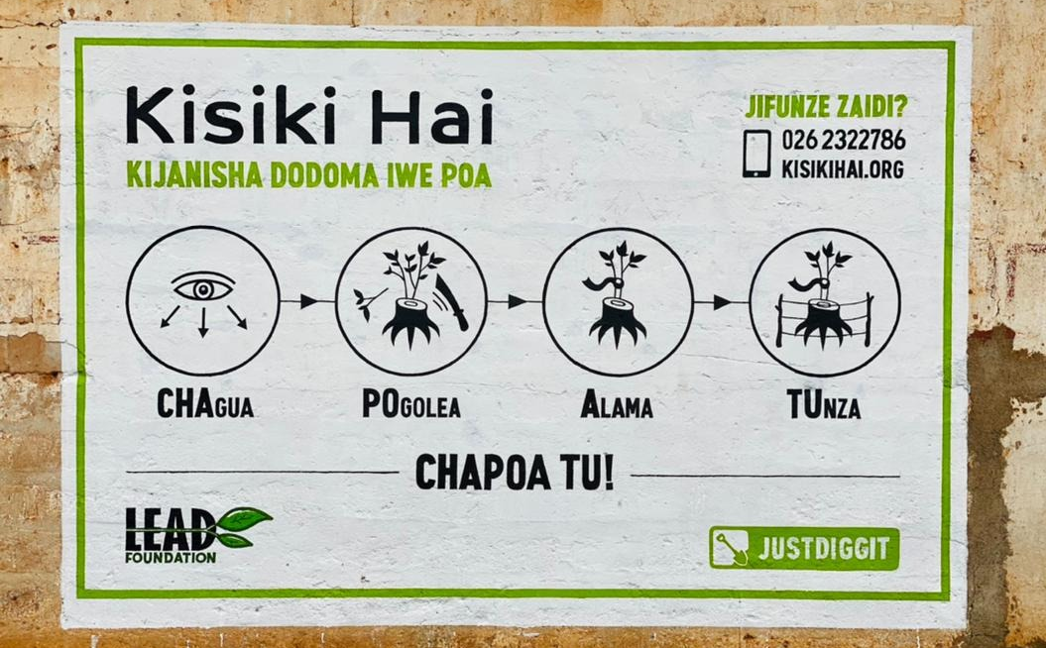
NEXT STEPS
With the training of the champion farmers, the first step of our regreening program is made. As we speak, they are training farmers in their villages and spreading the regreening movement. Other farmers will start practising FMNR and implement rainwater harvesting one by one. Through our monitoring system, we will continuously collect data on the progress in terms of households trained, activated and number of trees regenerated.
In the months to come, our rural marketing team will organise activities to promote regreening practices through our communication channels. The main activity is organising a movie roadshow, as can be seen in the picture. During this full-day event, the community gathers to celebrate the regreening movement through dance, speeches, songs and by watching the Kisiki Hai movie produced by our team. Other channels involve a weekly SMS service to which farmers can freely subscribe to receive messages on FMNR and regreening, placing billboards, painting murals and potentially designing a radio program. Through these channels, we aim to strengthen the regreening message in our program area and to reach even more people outside it!
The next report is scheduled for July 1st 2022.
A large crowd watching the regreening movie during one of our earlier movie roadshows
One of the murals, promoting FMNR
Notes:
Note:
- Movie roadshow happened al ready but not mentioned yet – will be reported on in the next report

Slide 8
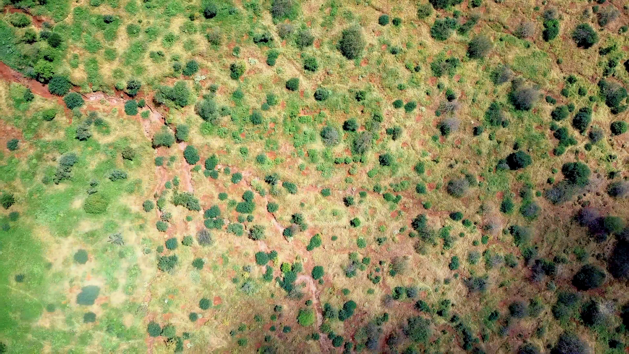
THANK YOU!

